Slide 1
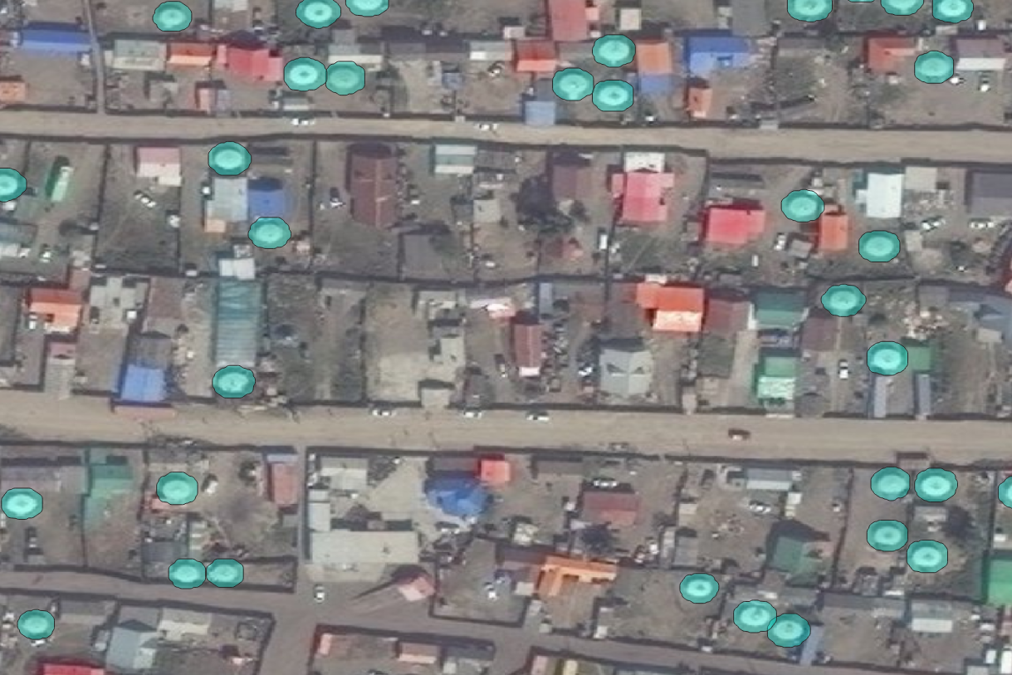
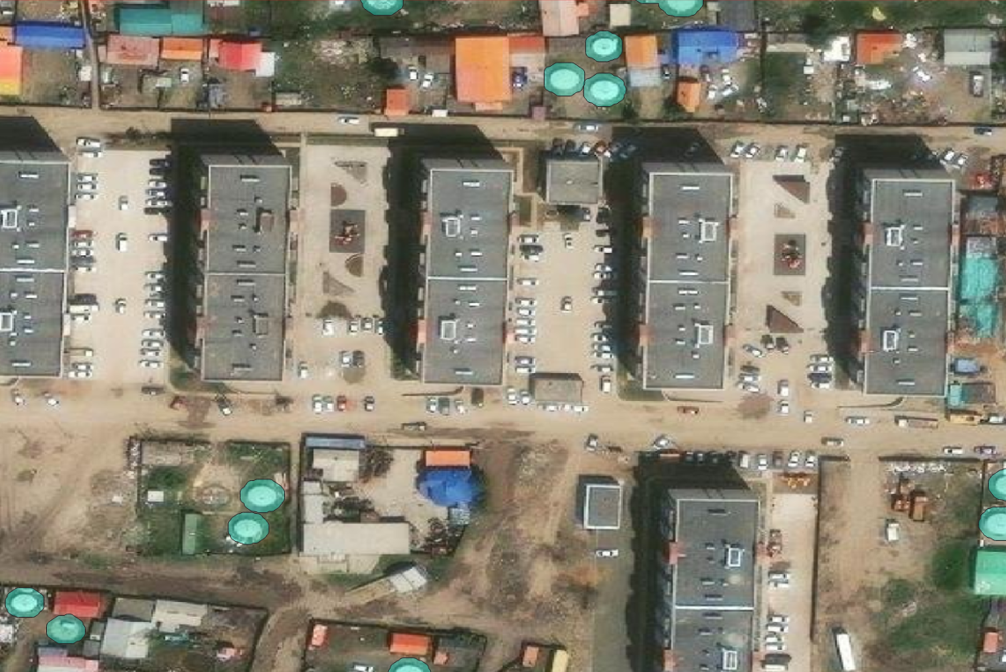
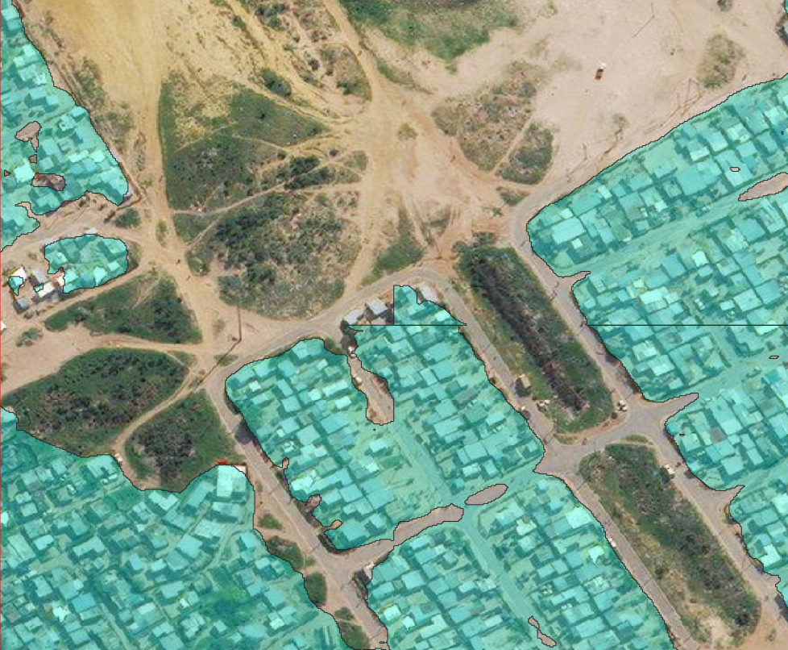
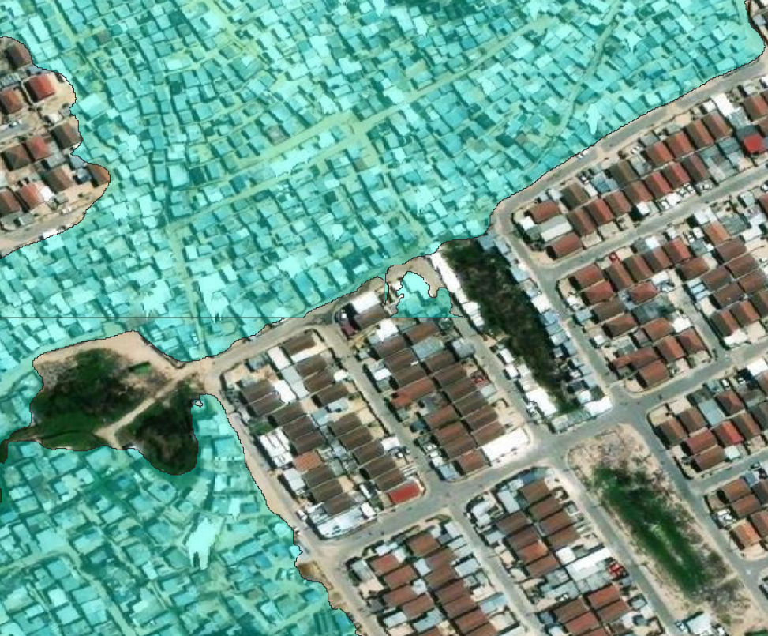
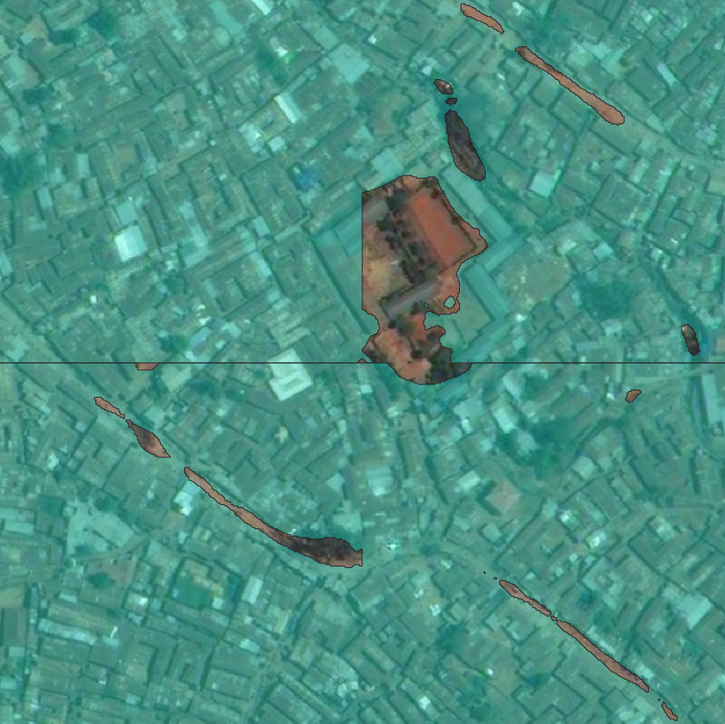
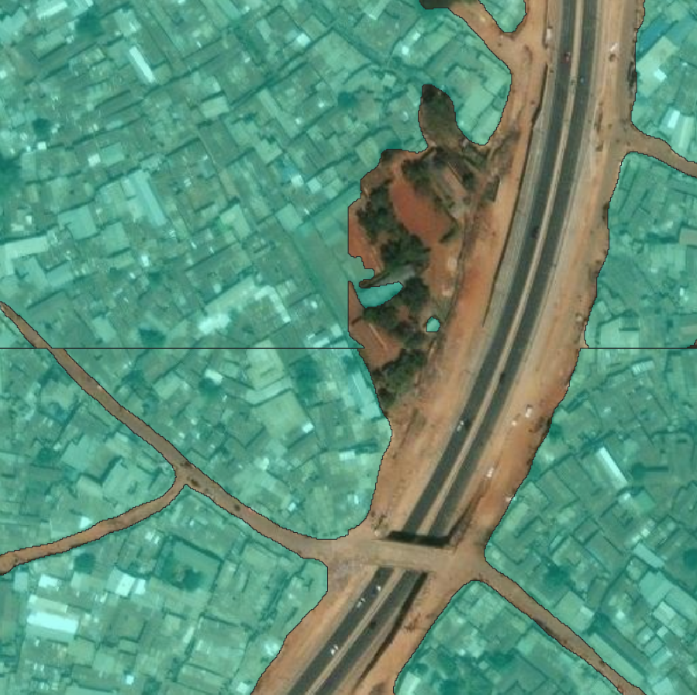
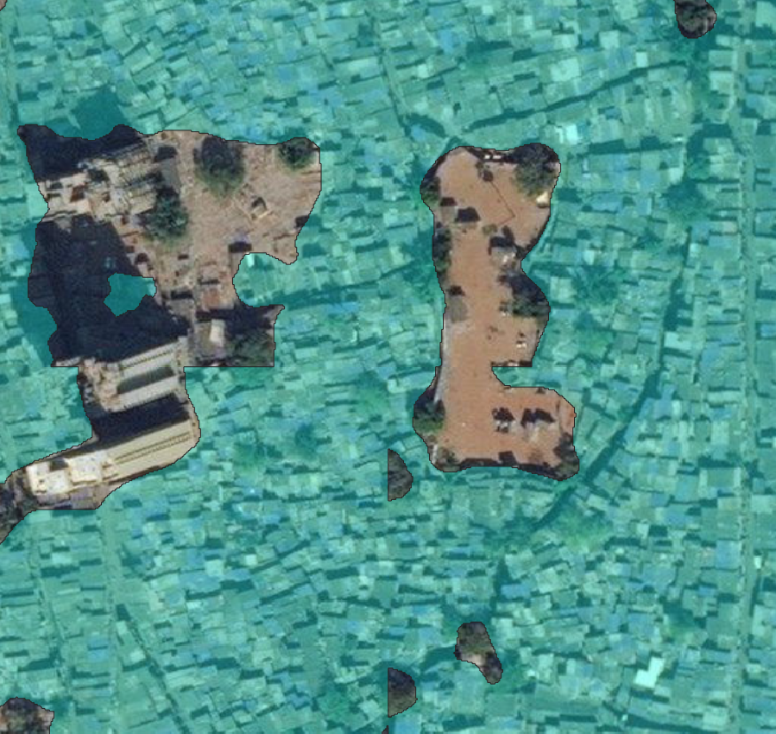
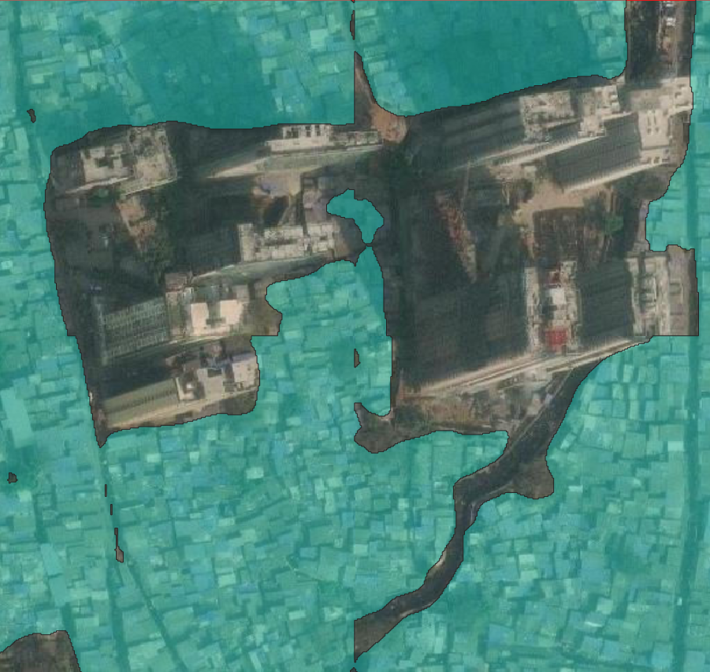
Slum upgrading projects
Ulaanbaatar
Cape Town
2016 AUG
2023 JUL
2015 SEP
2023 DEC
47.9117
-33.9980
47.9099
-34.0003
106.9889
106.9917
18.6795
18.6823
Non-slum-specific projects
Nairobi
Mumbai
2014 JAN
2023 FEB
2016 JAN
2023 JAN
-1.3114
19.2009
-1.3141
19.1983
36.7891
36.7918
72.8641
72.8668
Detected slums

